Slide 1









Whiteboardmaths.com
7
2
1
5
© 2004 All rights reserved

Slide 2

A Pythagorean Treasury
Slide 1: This menu
Slide 2: Historical and cultural Introduction (Print off the notes!).
Slides 3 to 6: The Theorem + 3 triples.
Slide 7: Perigal’s Dissection.
Slides 8 to 18: Basic questions + Applications to problems.
Slides 19 to 25: Historical and cultural aspects. (pre-amble to proofs)
Slide 26: Menu of seven proofs.
Slides 27 to 29: Famous people and the impact of deductive proof.
Slides 30 to 37: The seven proofs.
Slides 38/9: Pythagoras in 3D
Slides 40 to 42: Irrational lengths/spirals
Slides 43/44: Pythagorean Triples (Determine the Rule).
Slide 45: Investigation for similar shapes.
Slide 46: Resource sheet for 3
**To Start from a specific slide: select View Show/Right click/goto slide number**

Slide 3
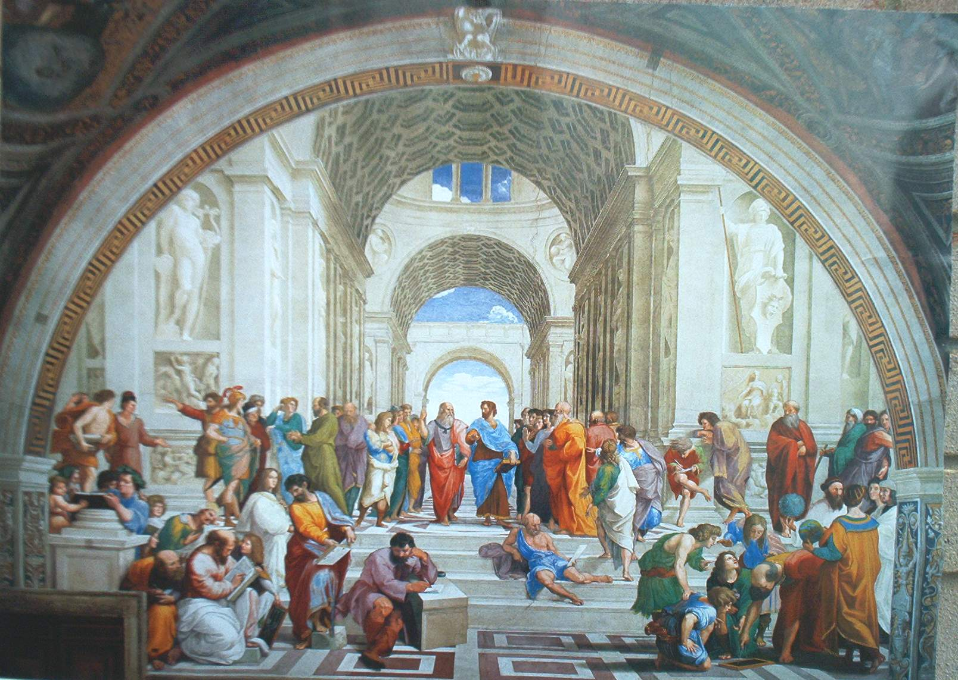
THE SCHOOL of ATHENS (Raphael) 1510 -11
Socrates
Plato
Aristotle
Pythagoras
Euclid
“All Men by nature desire knowledge”: Aristotle.

Slide 4
The Theorem of Pythagoras
In a right-angled triangle, the square on the hypotenuse is equal to the sum of the squares on the other two sides.
a²
Pythagoras of Samos
(6C BC)
b²
a
Hypotenuse
b
c
a² = b²+c²
c²
Notes:
Slide 43 is a resource sheet that gives the students the opportunity to discover the relationship for themselves.

Slide 5
A Pythagorean Triple
In a right-angled triangle, the square on the hypotenuse is equal to the sum of the squares on the other two sides.
3, 4, 5
25
9
5
3
4
3²+ 4²= 5²
16
9 + 16 = 25

Slide 6
A 2nd Pythagorean Triple
In a right-angled triangle, the square on the hypotenuse is equal to the sum of the squares on the other two sides.
5, 12, 13
169
25
13
5
12
5² + 12²= 13²
144
25 + 144 = 169

Slide 7
A 3rd Pythagorean Triple
In a right-angled triangle, the square on the hypotenuse is equal to the sum of the squares on the other two sides.
625
7, 24, 25
25
49
7
24
576
7²+ 24²= 25²
49 + 576 = 625

Slide 8
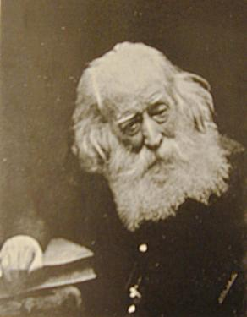
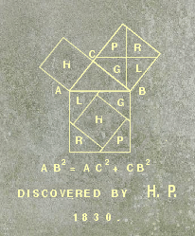
The Theorem of Pythagoras: A Visual Demonstration
In a right-angled triangle, the square on the hypotenuse is equal to the sum of the squares on the other two sides.
Henry Perigal (1801 – 1898)
Perigal’s Dissection
Gravestone Inscription
Draw 2 lines through the centre of the middle square, parallel to the sides of the large square
This divides the middle square into 4 congruent quadrilaterals
These quadrilaterals + small square fit exactly into the large square

Slide 9

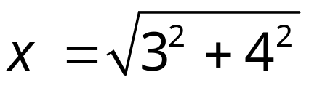


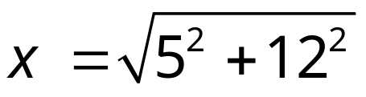

Pythagoras Questions
1
x
3 cm
4 cm
2
x
5 cm
12 cm

Slide 10

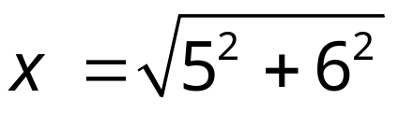
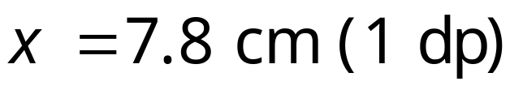

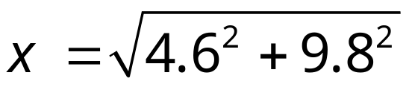
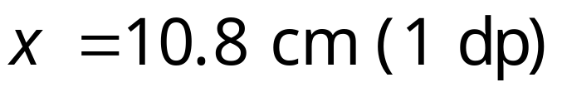
Pythagoras Questions
3
x
5 cm
6 cm
4
x
4.6 cm
9.8 cm

Slide 11

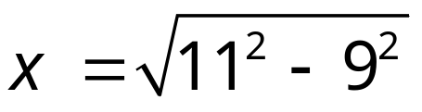
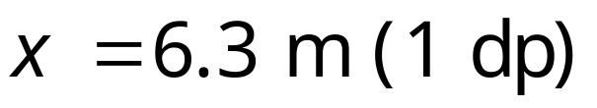

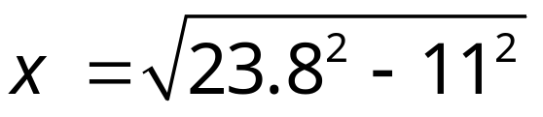
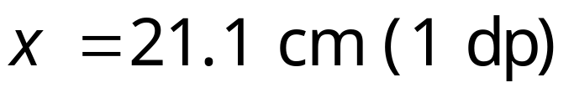
Pythagoras Questions
5
11m
x m
9 m
6
23.8 cm
11 cm
x cm

Slide 12

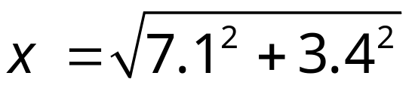
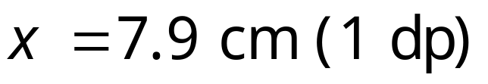

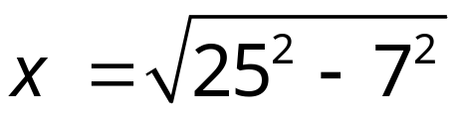

Pythagoras Questions
7
3.4 cm
7.1 cm
x cm
8
x m
25 m
7 m

Slide 13

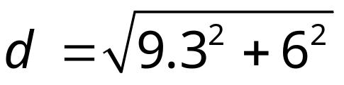
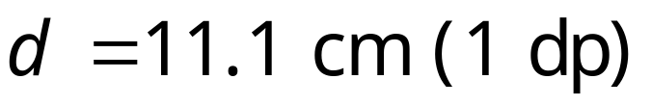

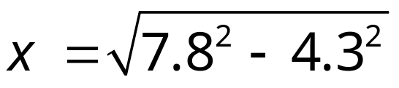
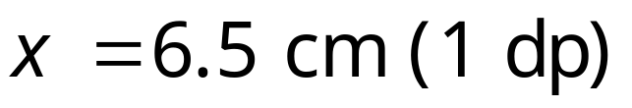
Applications of Pythagoras
1
Find the diagonal of the rectangle
d
6 cm
9.3 cm
2
A rectangle has a width of 4.3 cm and a diagonal of 7.8 cm. Find its perimeter.
4.3 cm
7.8 cm
x cm
∴Perimeter = 2(6.5+4.3) = 21.6 cm

Slide 14

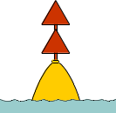

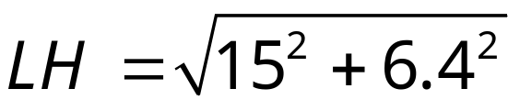


Applications of Pythagoras
A boat sails due East from a Harbour (H), to a marker buoy (B), 15 miles away. At B the boat turns due South and sails for 6.4 miles to a Lighthouse (L). It then returns to harbour. Make a sketch of the journey. What is the total distance travelled by the boat?
15 miles
H
B
6.4 miles
L
∴Total distance travelled = 21.4 + 16.3 = 37.7 miles

Slide 15

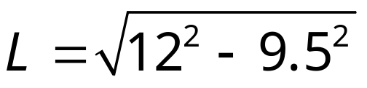

Applications of Pythagoras
A 12 ft ladder rests against the side of a house. The top of the ladder is 9.5 ft from the floor. How far is the base of the ladder from the house?
12 ft
9.5 ft
L

Slide 16



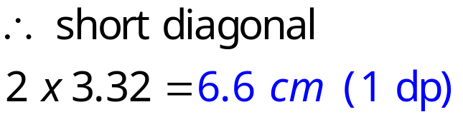

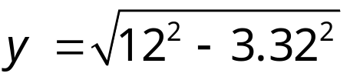

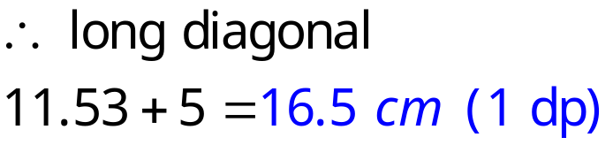
Find the diagonals of the kite
5 cm
6 cm
5 cm
x cm
y cm
12 cm

Slide 17




An aircraft leaves RAF Waddington (W) and flies on a bearing of NW for 130 miles and lands at a another airfield (A). It then takes off and flies 170 miles on a bearing of NE to a Navigation Beacon (B). From (B) it returns directly to Waddington. Make a sketch of the flight. How far has the aircraft flown?
B
170 miles
A
130 miles
W

Slide 18

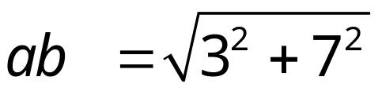
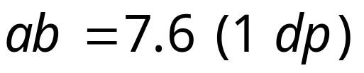
Find the distance between two points, a and b with the given
co-ordinates. a(3, 4) and b(-4, 1)
a
3
b
7

Slide 19

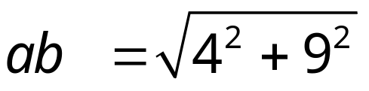
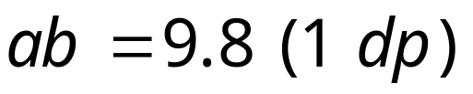
Find the distance between two points, a and b with the given
co-ordinates. a(4, -5) and b(-5, -1)
b
9
4
a

Slide 20
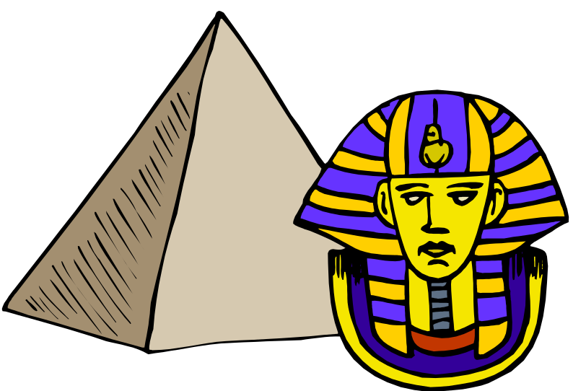
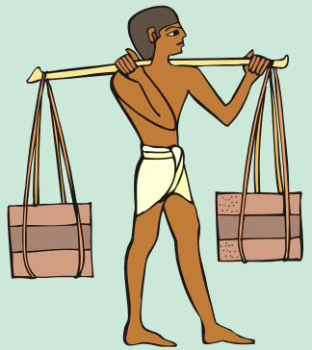
Ancient Egypt (2000 B.C.)
Rope with 12 equally spaced knots.
The Egyptians new about the 3. 4, 5 triangle. They were able to use this knowledge in the construction of pyramids, temples and other buildings to ensure a perfect right-angle at the corners.
They probably didn’t know any other configurations such as (5, 12, 13) and they certainly didn’t know why it made a right-angle. In applying this method they were in fact using the converse of what was to become Pythagoras’ Theorem, 1500 years into the future.

Slide 21
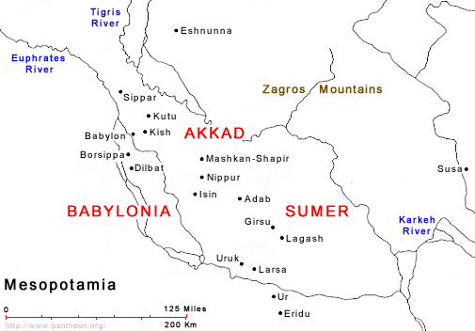
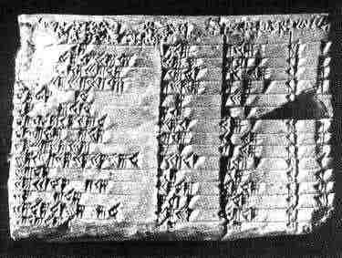
Mesopotamia
I R A Q
The Mesopotamians had a much more sophisticated system of mathematics than the Egyptians.
Bagdad
Plimpton 322 Tablet (1900 – 1600 B.C)
This clay tablet is written in Babylonian cuneiform text. The numbers are in base 60, not base 10.The text has been deciphered to reveal sets of “Pythagorean Triples”. The Mesopotamians had a much clearer understanding of Pythagoras’ Theorem than the Egyptians, although they still could not understand why such sets of triples existed. They had no idea how to produce a general proof.

Slide 22
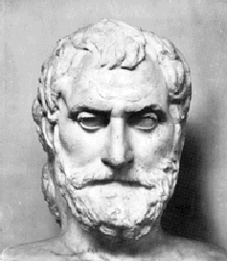


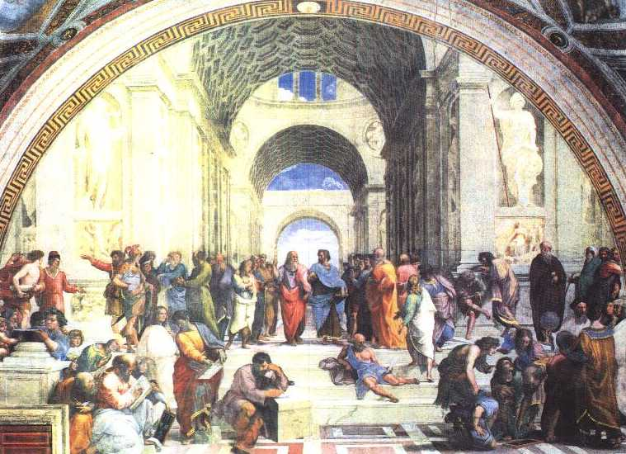
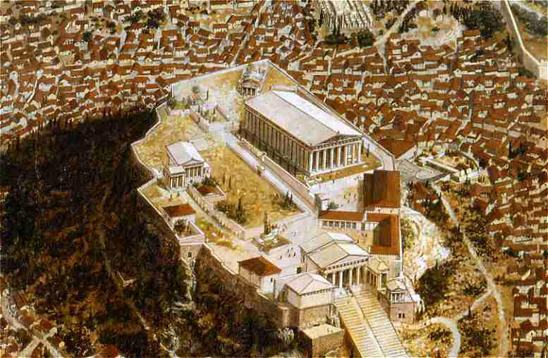
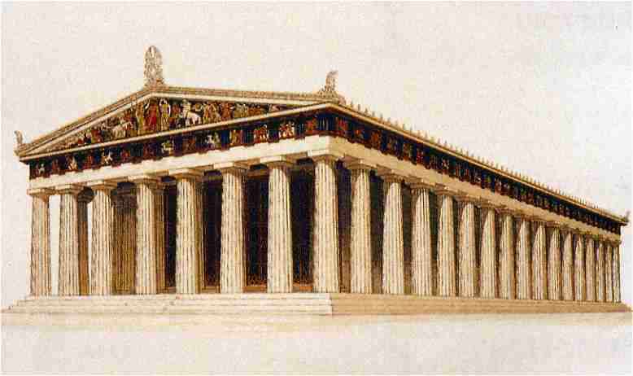
Ancient Greece
Thales of Miletus 640 – 546 B.C. The first Mathematician. He predicted the Solar eclipse of 585 B.C
c
a
a² + b² = c²
Plato’s Academy (387 B.C.)
b
Pythagoras (570-500 b.c.)
Aerial view of the Parthenon (447 – 432 B.C.)
Reconstructed Parthenon (built on the golden ratio)

Slide 23
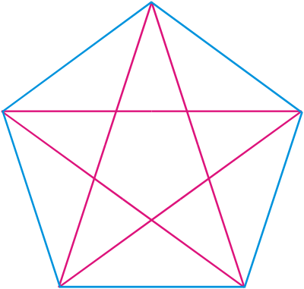

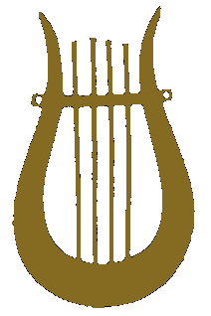
The Pythagoreans
Pythagoras was a semi-mystical figure who was born on the Island of Samos in the Eastern Aegean in about 570 B.C. He travelled extensively throughout Egypt, Mesopotamia and India absorbing much mathematics and mysticism. He eventually settled in the Greek town of Crotona in southern Italy.
Spirit
Pythagoras
He founded a secretive and scholarly society there that become known as the “Pythagorean Brotherhood”. It was a mystical almost religious society devoted to the study of Philosophy, Science and Mathematics. Their work was based on the belief that all natural phenomena could be explained by reference to whole numbers or ratios of whole numbers. Their motto became “All is Number”.
Air
Water
They were successful in understanding the mathematical principals behind music. By examining the vibrations of a single string they discovered that harmonious tones only occurred when the string was fixed at points along its length that were ratios of whole numbers. For instance when a string is fixed 1/2 way along its length and plucked, a tone is produced that is 1 octave higher and in harmony with the original. Harmonious tones are produced when the string is fixed at distances such as 1/3, 1/4, 1/5, 2/3 and 3/4 of the way along its length. By fixing the string at points along its length that were not a simple fraction, a note is produced that is not in harmony with the other tones.
Earth
Pentagram
Fire

Slide 24
Pythagoras and his followers discovered many patterns and relationships between whole numbers.
Triangular Numbers:
1 + 2 + 3 + ...+ n
= n(n + 1)/2
Square Numbers:
1 + 3 + 5 + ...+ 2n – 1
= n²
Pentagonal Numbers:
1 + 4 + 7 + ...+ 3n – 2
= n(3n –1)/2
Hexagonal Numbers:
1 + 5 + 9 + ...+ 4n – 3
= 2n²-n
These figurate numbers were extended into 3 dimensional space and became polyhedral numbers. They also studied the properties of many other types of number such as Abundant, Defective, Perfect and Amicable.
In Pythagorean numerology numbers were assigned characteristics or attributes. Odd numbers were regarded as male and even numbers as female.
→ The number of reason (the generator of all numbers)
→ The number of opinion (The first female number)
→ The number of harmony (the first proper male number)
→ The number of justice or retribution, indicating the squaring of accounts (Fair and square)
→ The number of marriage (the union of the first male and female numbers)
→ The number of creation (male + female + 1)
10. → The number of the Universe (The tetractys. The most important of all numbers representing the sum of all possible geometric dimensions. 1 point + 2 points (line) + 3 points (surface) + 4 points (plane)

Slide 25
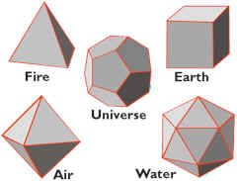
The Pythagorean School consisted of about 600 followers. They believed in the re-incarnation and the transmigration of the soul and followed certain taboos. They would not eat meat or lentils and would not wear wool clothing. The members were expected to understand the teachings of their leader and make contributions to the school by way of original ideas or proofs. They were sworn to secrecy and any new discovery had to be kept within the group. One member was punished by drowning, after he publicly announced the discovery of the 5th regular polyhedron (Do-decahedron).
Tetrahedron
Hexahedron
Do-decahedron
Octahedron
Icosahedron
It is not completely certain that it was Pythagoras himself that discovered the proof named after him. It could have been a member of the brotherhood. Legend has it that the discovery of the proof led to celebrations that included the sacrifice of up to 100 oxen. This seems a little improbable given that they were all vegetarians.
What Makes The Theorem So Special? The establishment of many theorems are based on properties of objects that appear intuitively obvious. For example, base angles of an isosceles triangle are equal or the angle in a semi-circle is a right angle. This is not at all the case with Pythagoras. There is no intuitive feeling that such an intimate connection exists between right angles and sums of squares. The existence of such a relationship is completely unexpected. The theorem establishes the truth of what is quite simply, an extremely odd fact.

Slide 26
Proving The Theorem of Pythagoras
There are literally hundreds of different proofs of Pythagoras’ Theorem. The original 6th Century BC proof is lost and the next one is attributed to Euclid of Alexandria (300 BC) who wrote “The Elements”. He proves the Theorem at the end of book I (I.47) after first proving 46 other theorems. He used some of these other theorems as building blocks to establish the proof. This proof is examined later.
The Chinese may have discovered a proof sometime during the 1st millennium as a diagram similar to that shown, appears in a text called Chou pei suan ching. Although no formal proof was left behind the diagram clearly indicates that they had knowledge of 3,4, 5 triangles.
Their reasoning was that the area of the centre square was the same as the combined area of the 4 triangles + the small square contained within.
Area = 4 x 6 + 1 = 25 = (Square on hypotenuse) of a triangle with sides 3 and 4. So the third side = 5.
Some people have suggested that Pythagoras may have used a similar approach in his proof.
We will now examine a possible approach to a proof based on this idea shortly.
hsuan-thu

Slide 27
A Collection of some of the Finest Proofs.
Proof 1 (adapted) ← ← : Possibly Greek (Pythagoras)/Chinese: (6C BC →1000AD)
Concepts needed: angles sum of a triangle/straight line/congruence/area of triangle/expansion of double brackets/simple equations
Proof 2 (adapted) ← Bahskara (12th century)
Concepts needed: Area of a triangle/expansion of Double brackets.
Proof 3 (adapted) ← ← ← : President Garfield’s (1876)
Concepts needed: angle sum of a triangle/straight line/area of a triangle/area of a trapezium/expansion of double brackets/simple equations/algebraic manipulation
Proof 4 John Wallis: ← ← ← ←(A similarity proof with no reference to area) (17 C)
Concepts needed:angle sum of a triangle/similar triangles/algebraic manipulation
Proof 5 (adapted) ← ← ← ← ← Euclid (The Elements: I.47) (300 BC)
Concepts needed: Congruence (SAS)/Area of a triangle = ½ area of a parallelogram on the same base. Some preparation needs to be given to this before attempting it.
Proof 6 (adapted) ← ← ← Euclid (The Elements: I.48) Converse of the Theorem (300 BC)
Concepts needed: Angle sum of a triangle/Pythagoras’ Theorem/Congruence (SSS)
Proof 7 ← Perigal’s visual demonstration of his proof (Proof details are omitted) (1830)
Difficulty level: ← to ← ← ← ← ← Remember when showing proofs 1/4/5 that Algebra was a long way in the future and that everything was based on the Geometry of the situation. Distances were regarded as line segments.

Slide 28
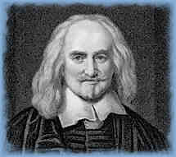
Geometric Proofs
Thomas Hobbes: Philosopher and scientist (1588 – 1679)
He was 40 years old before he looked in on Geometry, which happened accidentally. Being in a Gentleman’s library, Euclid’s Elements lay open and twas the 47 El libri 1. He read the proposition. By God sayd he (he would now and then swear an emphaticall Oath by way of emphasis) this is impossible! So he reads the Demonstration of it which referred him back to such a Proposition, which proposition he read. That referred him back to another which he also read. Et sic deinceps that at last he was demonstratively convinced of the trueth. This made him in love with Geometry.
From the life of Thomas Hobbes in John Aubrey’s Brief Lives, about 1694

Slide 29
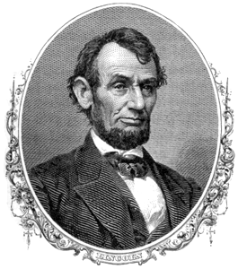
Abraham Lincoln: 16th U.S. President
(1809 – 65)
…"He studied and nearly mastered the Six-books of Euclid (geometry) since he was a member of Congress. He began a course of rigid mental discipline with the intent to improve his faculties, especially his powers of logic and language.
Hence his fondness for Euclid, which he carried with him on the circuit till he could demonstrate with ease all the propositions in the six books; often studying far into the night, with a candle near his pillow, while his fellow-lawyers, half a dozen in a room, filled the air with interminable snoring.“….
(Abraham Lincoln from Short Autobiography of 1860.)

Slide 30
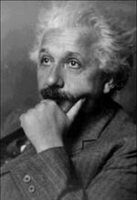
Albert Einstein
E = mc²
At the age of twelve I experienced a second wonder of a totally different nature: in a little book dealing with Euclidean plane geometry, which came into my hands at the beginning of a school year. Here were assertions as for example, the intersection of the 3 altitudes of a triangle in one point, which– though by no means evident, could nevertheless be proved with such certainty that any doubt appeared to be out of the question. This lucidity and certainty, made an indescribable impression upon me.
For example I remember that an uncle told me the Pythagorean Theorem before the holy geometry booklet had come into my hands. After much effort I succeeded in “proving” this theorem on the basis of similarity of triangles. For anyone who experiences [these feelings] for the first time, it is marvellous enough that man is capable at all to reach such a degree of certainty and purity in pure thinking as the Greeks showed us for the first time to be possible in geometry. From pp 9-11 in the opening autobiographical sketch of Albert Einstein: Philosopher – Scientist, edited by Paul Arthur.Schillp, published 1951

Slide 31
A Proof of Pythagoras Theorem
To prove that a² + b² = c²
a
b
xº
yº
We first need to show that the shape in the middle is a square.
The sides are equal in length since each is the hypotenuse of congruent triangles.✓
The angles are all 90º since x+y = 90⁰ and angles on a straight line add to 180º ✓
a
c
xº
b
c
yº
Area of large square
= (a + b)² = a² + 2ab + b²
Area of large square is also
= c² + 4 x ½ ab = c² + 2ab
So
⇒ a² + 2ab + b² = c² + 2ab
⇒ a² + b² = c² QED
yº
b
c
xº
c
a
yº
xº
b
a
Take 3 identical copies of this right-angled triangle and arrange like so.

Slide 32
Bhaskara’s Proof (Indian Mathematician 12th century)
Bhaskara’s approach is to partition the square on the hypotenuse into 4 right-angled triangles that are congruent to the original, plus a central square.
b-a
To prove that a² + b² = c²
c² = 4 x ½ ab + (b-a)²
c² = 2ab + b² –2ab + a²
c² = a² + b² (QED)
a
c
b

Slide 33
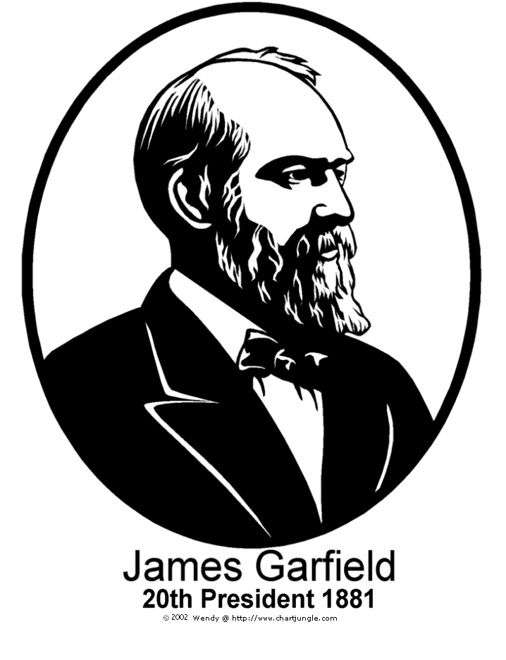

President James Garfield’s Proof(1876)
To prove that a² + b² = c²
We first need to show that the angle between angle x and angle y is a right angle.
This angle is 90º since x + y = 90º and angles on a straight line add to 180º ✓
Draw line:The boundary shape is a trapezium
Area of trapezium
= ½ (a + b)(a + b) = ½ (a² +2ab + b²)
Area of trapezium is also equal to the areas of the 3 right-angled triangles.
= ½ ab + ½ ab + ½ c²
So
½ (a² +2ab + b²) = ½ ab + ½ ab + ½ c²
a² +2ab + b² = 2ab + c²
a² + b² = c² QED
yº
b
c
xº
c
a
yº
xº
b
a
Take 1 identical copy of this right-angled triangle and arrange like so

Slide 34
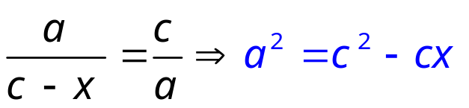
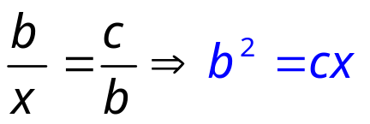
John Wallis Proof: English Mathematician (1616-1703)
Draw CD perpendicular to AB
C
Angle BDC is a right angle (angles on a straight line)
α
β
b
Angle BCD = α since α + β + 90º = 180º (from large triangle)
a
Angle ACD= β = since α + β + 90º = 180º (from large triangle)
β
x
α
A
All 3 triangles are similar since they are equiangular
B
D
c
Triangles ACB, CDB and ADC are similar
C
C
C
β
b
α
b
a
a
a
β
α
β
α
B
A
B
c - x
D
D
x
A
c
1
2
3
Comparing corresponding sides in 1 and 2:
Comparing corresponding sides in 1 and 3:

Slide 35
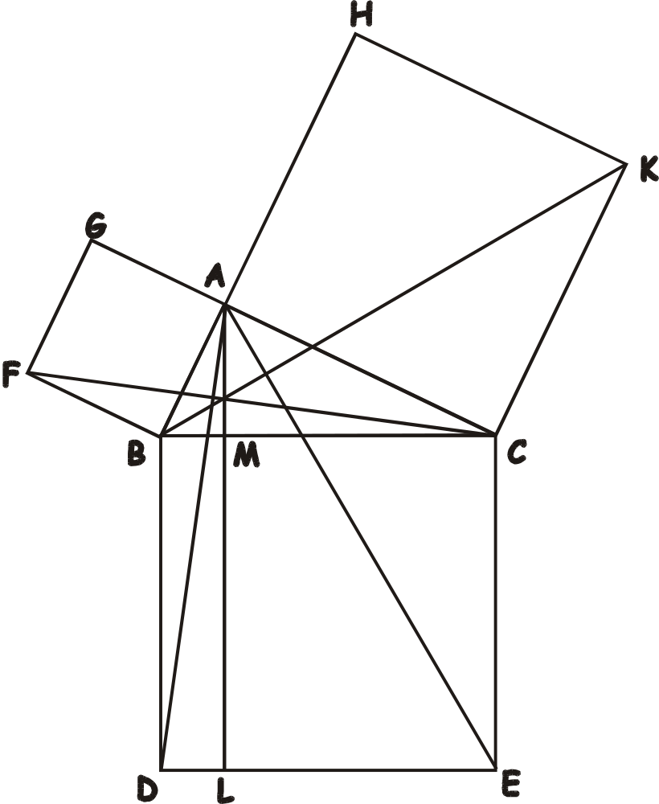
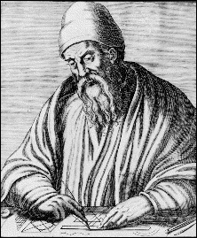
The Windmill
The Theorem of Pythagoras
Euclid 1.47
Euclid of Alexandria

Slide 36
Euclid’s Proof
To Prove that area of square BDEC = area of square ABFG + area of square ACHK
Construct squares on each of the 3 sides (1.46)
Draw AL through A parallel to BD (1.31)
H
Proof:
Draw Lines AD and FC
CA and AG lay on the same straight line (2 right angles)(1.14)
In triangles ABD and FBC AB = FB (sides of the same small square)
BD = BC (sides of the same larger square)
Also included angles are equal (right angle + common angle ABC)
∴triangles are congruent (SAS) and so are equal in area (1.4)
Rectangle BDLM = 2 x area of triangle ABD (1.41)
Square ABFG = 2 x area of triangle FBC (1.41)
∴Area of rectangle BDLM = Area of square ABFG
K
G
A
F
B
M
C
Draw lines BK and AE
BA and AH lay on the same straight line (2 right angles (1.14)
In triangles ACE and BCK, AC = CK (sides of smaller square)
BC = CE (sides of larger square)
Also included angles are equal (right angle + common angle ACB)
∴triangles are congruent (SAS) and so are equal in area (1.4)
Rectangle MLCE = 2 x area of triangle Ace (1.41)
Square ACHK = 2 area of triangle BCK (1.41)
∴Area of rectangle MLCE = Area of square ACHK
D
E
L
Area of square BDEC = area of square ABFG + area of square ACHK. QED

Slide 37
Euclid’s Proof of the Converse of Pythagoras’ Theorem (I.48)
To prove that: If the square on the hypotenuse
is equal to the sum of the squares on the other
two sides then the triangle contains a right angle.
The Proof
B
To prove that angle α is a right angle Given c² = a² + b²
c
a
Draw CE perpendicular to BC
α
A
Construct CD equal to CA and join B to D
E
b
D
C
Applying Pythagoras’ Theorem to triangle BCD
BD² = BC² + DC² (I.47)
BD² = a² + b² (since BC = a and DC = b)
BD² = c² (since a² + b² = c² given)
BD = c
Triangles BCD and BCA are congruent by (SSS) ∴angle α is a right angle QED

Slide 38
The Theorem of Pythagoras: A Visual Demonstration
In a right-angled triangle, the square on the hypotenuse is equal to the sum of the squares on the other two sides.
Henry Perigal (1801 – 1898)
Perigal’s Dissection
Gravestone Inscription
Draw 2 lines through the centre of the middle square, parallel to the sides of the large square
This divides the middle square into 4 congruent quadrilaterals
These quadrilaterals + small square fit exactly into the large square

Slide 39
Pythagoras in 3D Problems
The diagram shows a rectangular box with top ABCD and base EFGH.
(a) Find the distance BG (b) The angle FGB
A
B
(a)
Find fg first
FG² = 5² + 12²
FG = √(5² + 12²)
FG = 13 cm
3 cm
E
F
C
D
Use fg to find BG
BG² = 3² + 13²
FG = √(3² + 13²)
FG = 13.3 cm
13 cm
12 cm
G
H
5 cm
(b)
Tan FGB = 3/13
Angle FGB = 13º

Slide 40
The diagram shows a wedge in which rectangle ABCD is perpendicular to rectangle CDEF.
(a) Find the distance BE (b) Angle CEB
A
(a)
Find EC first
EC² = 5.4² + 9.2²
EC = √(5.4² + 9.2²)
EC = 10.67
D
B
3.1 cm
C
E
10.67
Use fg to find BG
BE² = 3.1² + 10.67²
BE = √(3.1² + 10.67²)
BE = 11.1 cm (1 dp)
9.2 cm
5.4 cm
F
(b)
Tan CEB = 3.1/10.67
Angle CEB = 16.2º

Slide 41
Incommensurable Magnitudes (Irrational Numbers)
The whole of Pythagorean mathematics and philosophy was based on the fact that any quantity or magnitude could always be expressed as a whole number or the ratio of whole numbers.
√2
1
The discovery that the diagonal of a unit square could not be expressed in this way is reputed to have thrown the school into crisis, since it undermined some of their earlier theorems.
1
Unit Square
Story has it that the member of the school who made the discovery was taken out to sea and drowned in an attempt to keep the bad news from other members of the school.
He had discovered the first example of what we know today as irrational numbers.

Slide 42
It is possible to draw a whole series of lengths that are irrational by following the pattern in the diagram below and using Pythagoras’ Theorem. Continue the diagram to produce lengths of √3, √5, √6, √7, etc. See how many you can draw. You should get an interesting shape.
1
√2
1
1

Slide 43
1
1
1
1
1
1
√10
√11
√9
1
√12
√8
√7
√13
1
1
√14
√6
1
√15
1
√5
1
√16
√4
1
√3
√2
1
1
√17
1
√18
1
1

Slide 44
Pythagorean Triples (Shortest side odd)
n
2n+1
?
?
2n² + 2n
2n² + 2n + 1
1
3
4
5
∝
2
5
12
13
3
7
24
25
4
9
40
41
5
11
60
61
6
13
84
85
∝
7
15
112
113
8
17
144
145
9
19
180
181
10
21
220
221
There are an infinite number of triples of this type

Slide 45
Pythagorean Triples (Shortest side even)
n
4n+4
?
?
4n² + 8n + 3
4n² + 8n + 5
1
8
15
17
∝
2
12
35
37
3
16
63
65
4
20
99(21)
101(29)
5
24
143
145
6
28
195(45)
197(53)
∝
7
32
255
257
8
36
323
325
9
40
399
401
10
44
483(117)
485(125)
There are an infinite number of triples of this type

Slide 46
INVESTIGATE

Slide 47
Measure the area of the squares on the side of the triangles below. What do you conclude?
Notes:
Resource Sheet 1

